Slide 1
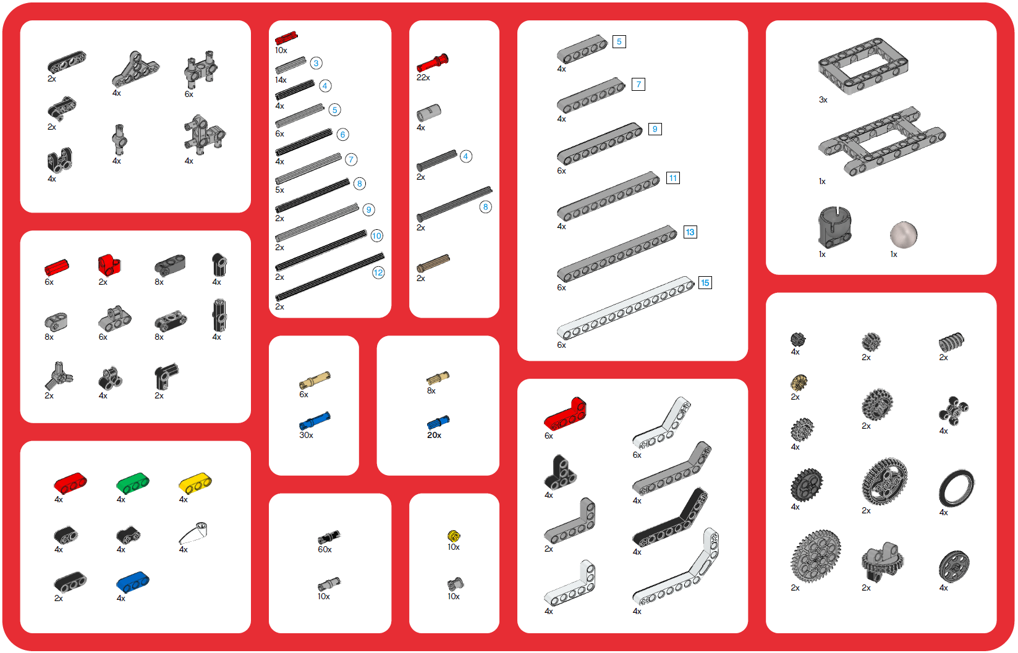
EV3 Core Set (45544) Top Tray Organizer

Slide 2
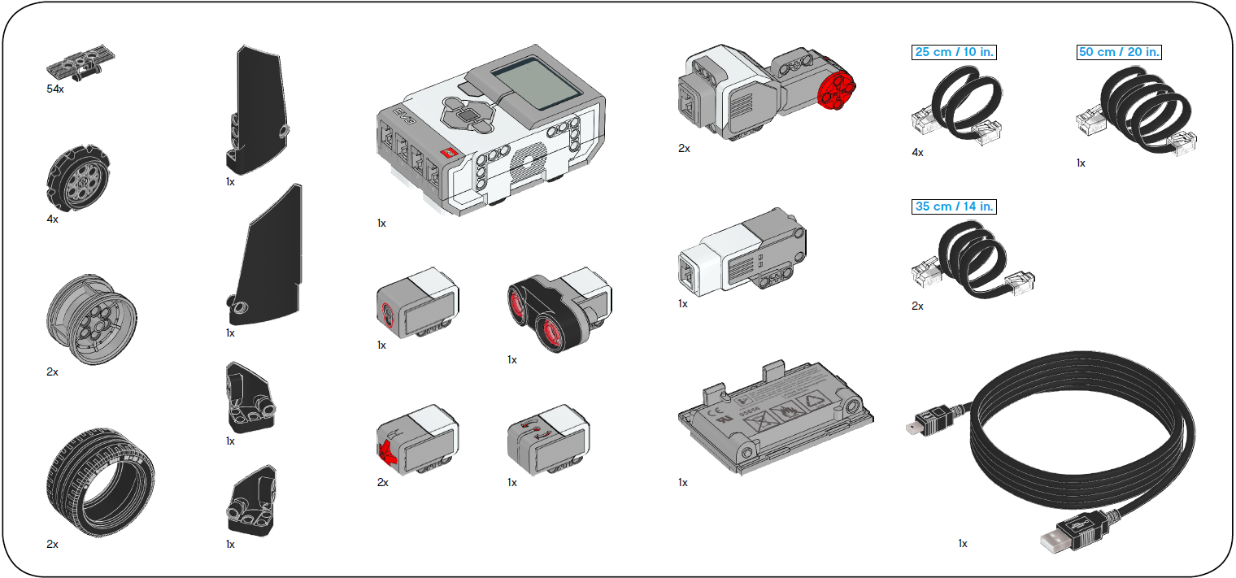
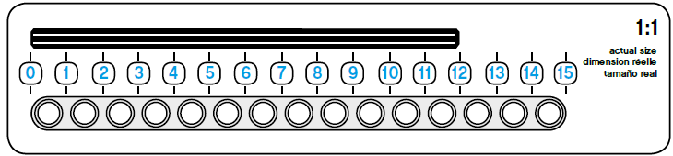
EV3 Core Set (45544) Bottom Tray Organizer

Slide 3
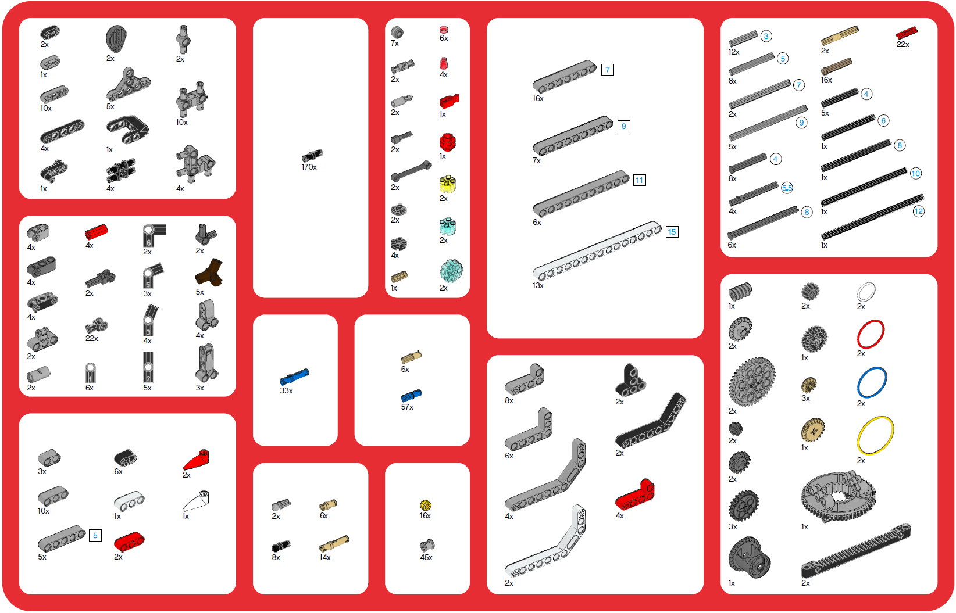
EV3 Expansion Set (45560) Top Tray Organizer

Slide 4
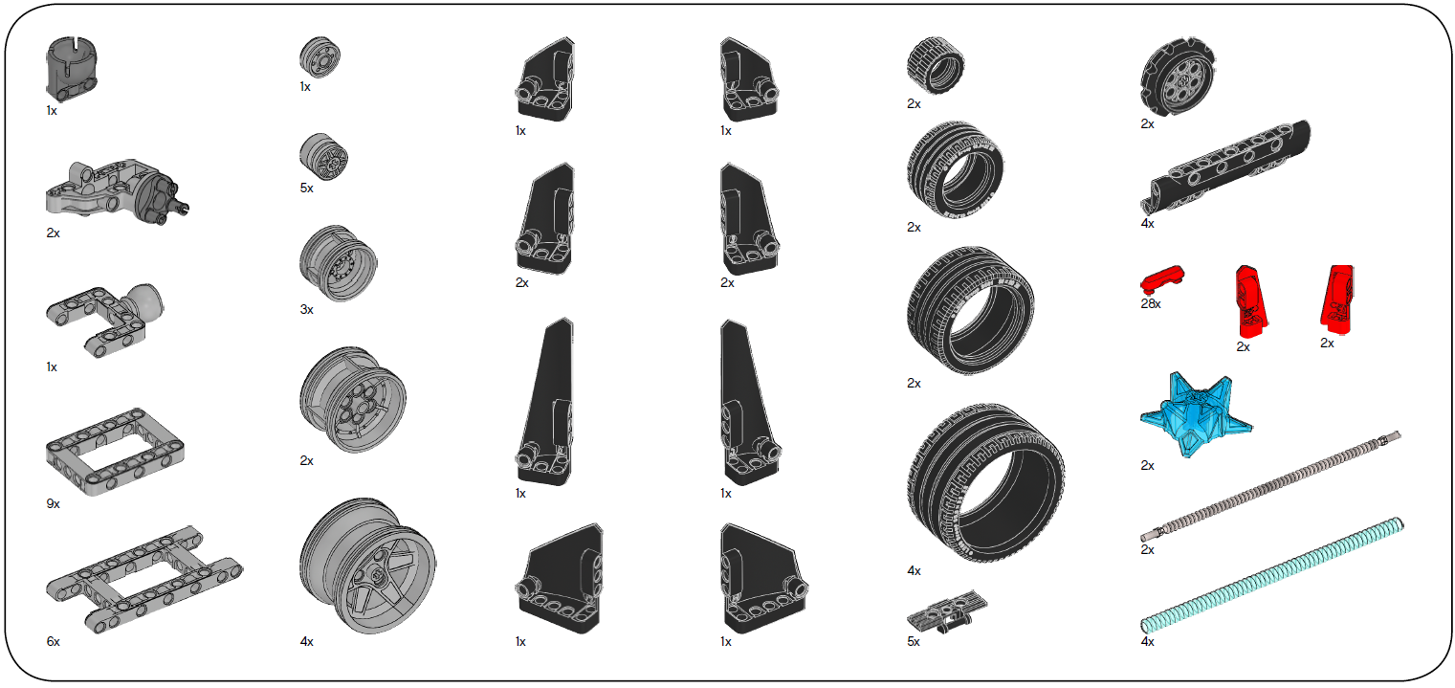
EV3 Expansion Set (45560) Bottom Tray Organizer

